Slide 1
Generative
Adversarial Networks
Ｍｅｍｂｅｒｓ：朱偉綸、黃秉茂、許齊崴

Slide 2
Trace Code
R: The original, genuine data set
I: The random noise that goes into the generator as a source of entropy
G: The generator which tries to copy/mimic the original data set
D: The discriminator which tries to tell apart G’s output from R
The actual ‘training’ loop where we teach G to trick D and D to beware G.

Slide 3
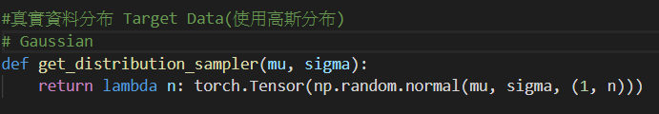
R
In our case, we’ll start with the simplest possible R (a bell curve). This function takes a mean and a standard deviation and returns a function which provides the right shape of sample data from a Gaussian with those parameters.
In our sample code, we’ll use a mean of 4.0 and a standard deviation of 1.25.

Slide 4
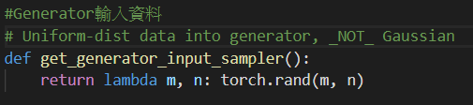
I
The input into the generator is also random, but to make our job a little bit harder, let’s use a uniform distribution rather than a normal one.
This means that our model G can’t simply shift/scale the input to copy R, but has to reshape the data in a non-linear way.

Slide 5
G
The generator is a standard feedforward graph — two hidden layers, three linear maps. We’re using a hyperbolic tangent activation function.
G is going to get the uniformly distributed data samples from I and somehow mimic the normally distributed samples from R (without ever seeing R).

Slide 6
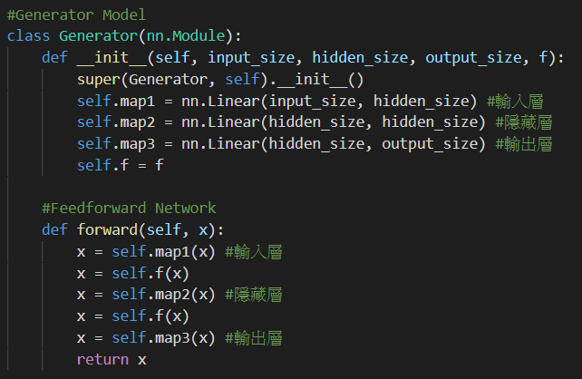

Slide 7
D
The discriminator code is very similar to G’s generator code; a feedforward graph with two hidden layers and three linear maps.
The activation function here is a sigmoid.
It’s going to get samples from either R or G and will output a single scalar between 0 and 1, interpreted as ‘fake’ vs. ‘real’.
In other words, this is about as milquetoast as a neural net can get.

Slide 8
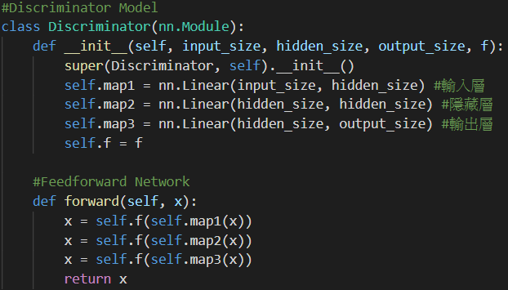

Slide 9
Finally, the training loop alternates between two modes: first training D on real data vs. fake data, with accurate labels, and then training G to fool D, with inaccurate labels . It’s a fight between real and fake, people.

Slide 10
For each epoch:
(1) We push both types of data through D and apply a differentiable criterion to D’s guesses vs. the actual labels. That pushing is the ‘forward’ step; we then call ‘backward()’ explicitly in order to calculate gradients, which are then used to update D’s parameters in the d_optimizer step() call. G is used but isn’t trained here.
(2)we do the same thing for G — note that we also run G’s output through D (we’re essentially giving the forger a detective to practice on) but we do not optimize or change D at this step. We don’t want the detective D to learn the wrong labels. Hence, we only call g_optimizer.step().

Slide 11
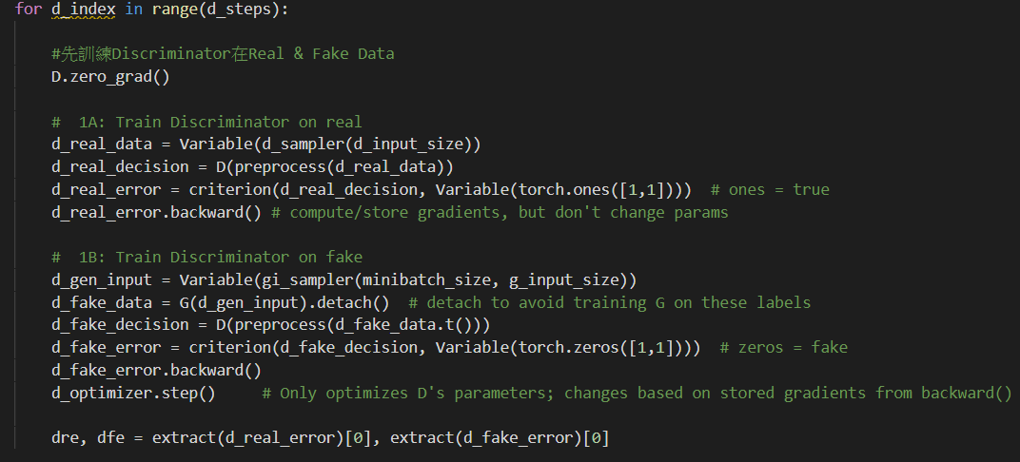
Training D(discriminator)

Slide 12
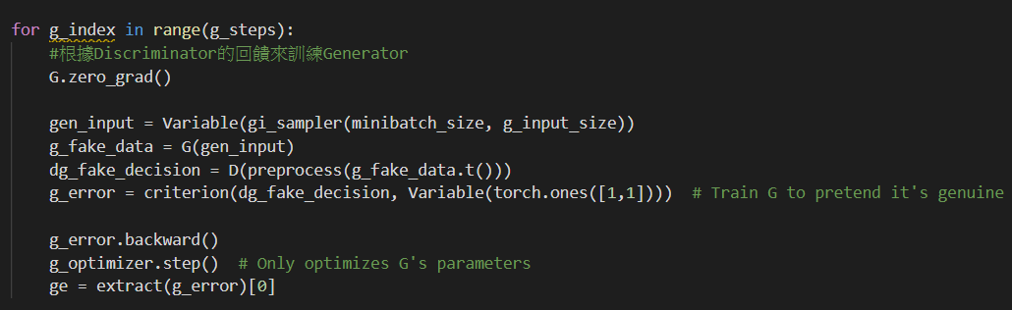
Training G(generator)

Slide 13
Key Point

Slide 14
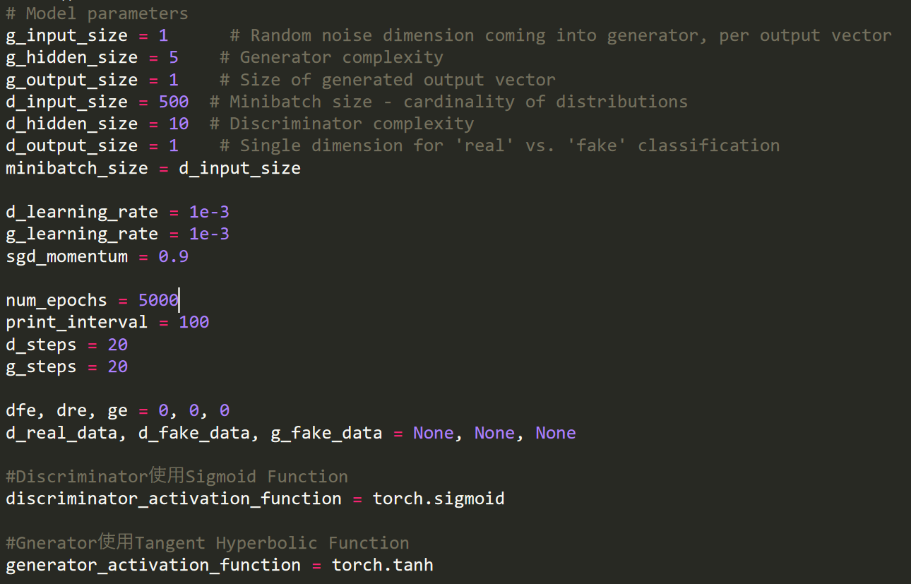
Hyper parameter

Slide 15
D(discriminator)'s Implementation Detail
Generate real data.
Training D with real data.
Calculate real loss and then calculate gradient with it.
Generate fake data from data which generate from G(generator).
Training D with fake data.
Calculate fake loss and then calculate gradient with it.
Update D’s parameter according to the gradient generated by real loss and fake loss.

Slide 16
D(discriminator)'s Vision
Hope the real loss is as small as possible
=> represents that it can distinguish which data is real more precisely
Hope the fake loss is as small as possible
=> represents that it can distinguish which data is fake more precisely
The smaller the loss is, the stricter the G (generator) will be

Slide 17
G(generator)'s Implementation Detail
Generate data.
Score D with data.
Calculate loss and then calculate gradient with it.
Update G’s parameter according to the gradient generated by loss.

Slide 18
G(generator)'s Vision
Smaller loss is better => it means that the generated data is fitter for our expectation.
The smaller the loss is, the more able to fool D (discriminator) to achieve a high score.

Slide 19
Other Implementation Key Point
Do not update G when updating D, vice versa.
Remember using zero_grad(), or the calculation of gradient will fail.
Since back propagation can deal with chain rule, we can only calculate gradient of data’s statistic.

Slide 20
Result

Slide 21
Over 5,000 training rounds, training D for 20 times and then G for 20 times in each round, the mean of G’s output overshoots 4 but then comes back in a fairly stable, correct range (left picture above in page). Likewise, the standard deviation initially drops in the wrong direction but then rises up to the desired 1.25 range (right picture in above page), matching R.

Slide 22
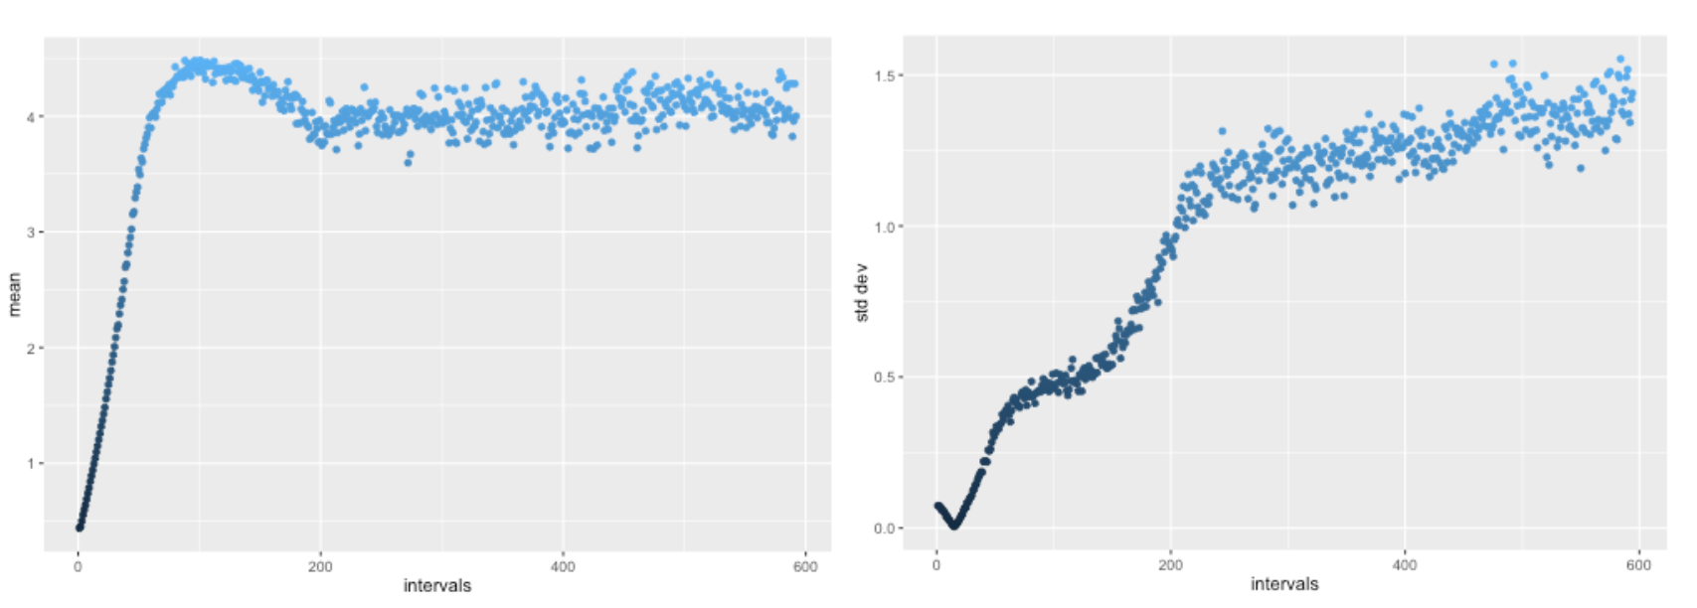

Slide 23
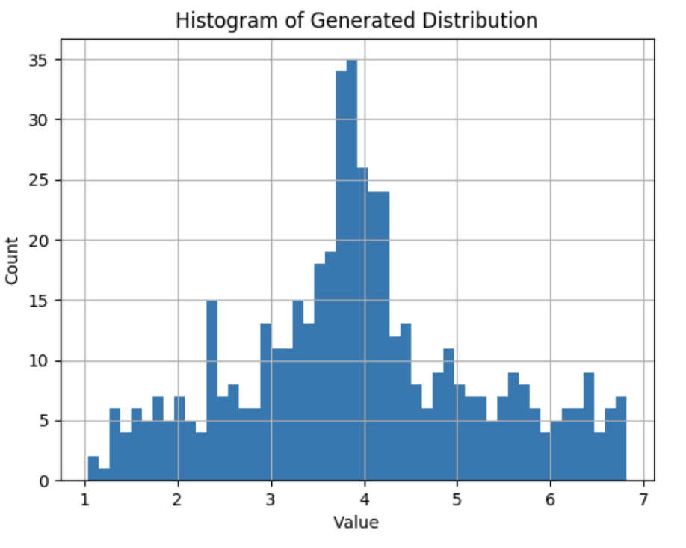

Slide 24
Conclusion

Slide 25
The power of GAN (Generative Adversarial Networks) is that it only needs to know the real data, and it can learn what he wants through the interaction between G and D, and we may be able to understand how and what the model would learn through the scoring mechanism of D. Moreover, perhaps its censorship standard is something that humans have never thought of, and therefore it may be more reasonable than human judgments in some aspects.

Slide 26
Resource
https://github.com/devnag/pytorch-generative-adversarial-networks?fbclid=IwAR355HFMPWE4i12-L51rmKEuLhe_GEEjsssJp87Y-DB7ILEuMv1II-FKwg8

Slide 27
Thanks for listening

